Slide 1
Airline vs auto travel safety
Cody Myers

Slide 2
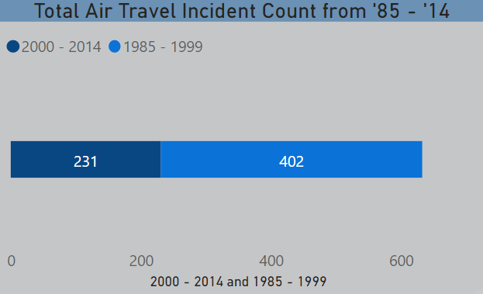
What is the cost of an automobile crash?
In 2013, there were 2.31 million people injured in car accidents. This translates to an incident happening every 14 seconds or 6,337 per day.
Total cost of the loss of life and productivity caused by auto accidents was approximately $1 trillion in 2010.
Less than 1000 airplane incidents from 1985 to 2014
The yearly cost for airplane incidents ranges from $1.6B to $4.6B. A fraction of the yearly cost in auto accidents.
Sources: Cost of auto crashes & statistics. (n.d.). Retrieved April 22, 2021, from http://www.rmiia.org/auto/traffic_safety/Cost_of_crashes.asp , Sobieralski, J. (2012, December 07). The cost of general aviation accidents in the United States. Retrieved April 26, 2021, from https://www.sciencedirect.com/science/article/abs/pii/S0965856412001577

Slide 3
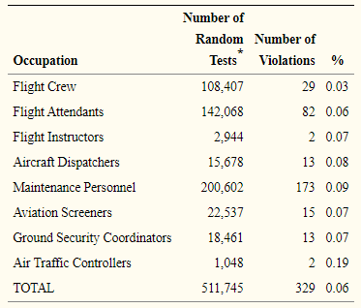
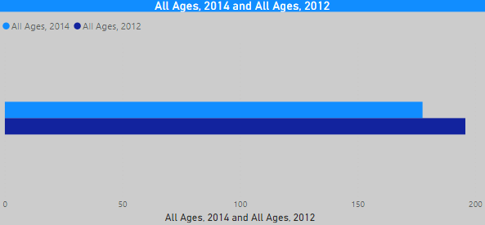
Alcohol related incidents
The chart above shows the number of fatal car accidents that involved alcohol in 2012 and 2014 per 100000, so this equates to about 45,000 drunk drivers in 2012 alone.
Source: National Highway Traffic Administration's (NHTSA) Fatality Analysis Reporting System (FARS), 2014 Annual Report File. Fatality rates based on fewer than 20 deaths are suppressed.
From 1995 – 2002, there were only 329 occurrences of anyone related to the flying of a plane being found to have a BAC above 0.0.
Source: Li, G., Baker, S., Qiang, Y., Rebok, G., & McCarthy, M. (2007, May). Alcohol violations and Aviation ACCIDENTS: Findings from the U.S. mandatory alcohol testing program. Retrieved April 25, 2021, from https://www.ncbi.nlm.nih.gov/pmc/articles/PMC2041869/

Slide 4
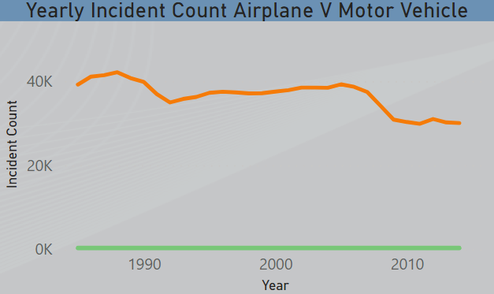
Incident Count per year
In 2014, there were 30,000+ lethal auto accidents, but only 231 incidents involving airplanes.
Year-over-year improvement on airplane incident statistics that have resulted in a 50% decrease in yearly incidents over the span on 30 years.
Yearly automobile related incidents remained stagnant until the mid-2000’s, but still has only been able to reduce the yearly count by 25% over the same 30-year period.

Slide 5
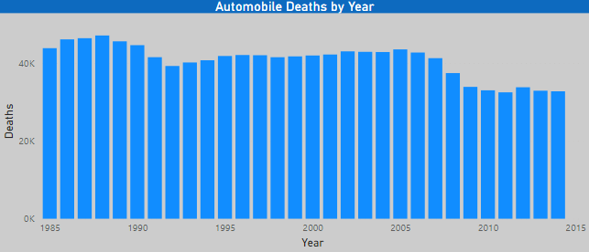
Automobile Deaths per year
Over the last 30 years automobile deaths have only decreased by about 25% with the yearly rate at about 32,000.
Small decrease in fatalities during the late 2000’s. but has remained stagnant since.
Death rates and incident rates are very similar for automobiles

Slide 6
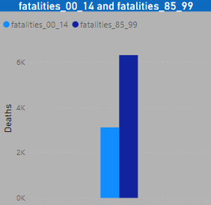
Airline deaths per year
There have been less than 9,000 deaths over the previous 30 years from airline travel
There are over four times as many automobile deaths per year than there have been airline accidents in the last 30.

